Slide 1
How to Acquire Business Skills without Getting an MBA
My Self-Learning During 8 Years of Running a Consulting Business
Peng Yang, Founder and President of Clindata Insight Inc.

Slide 2
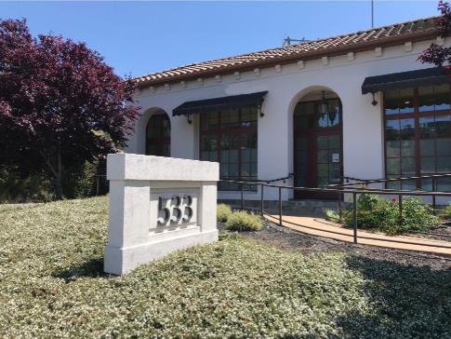
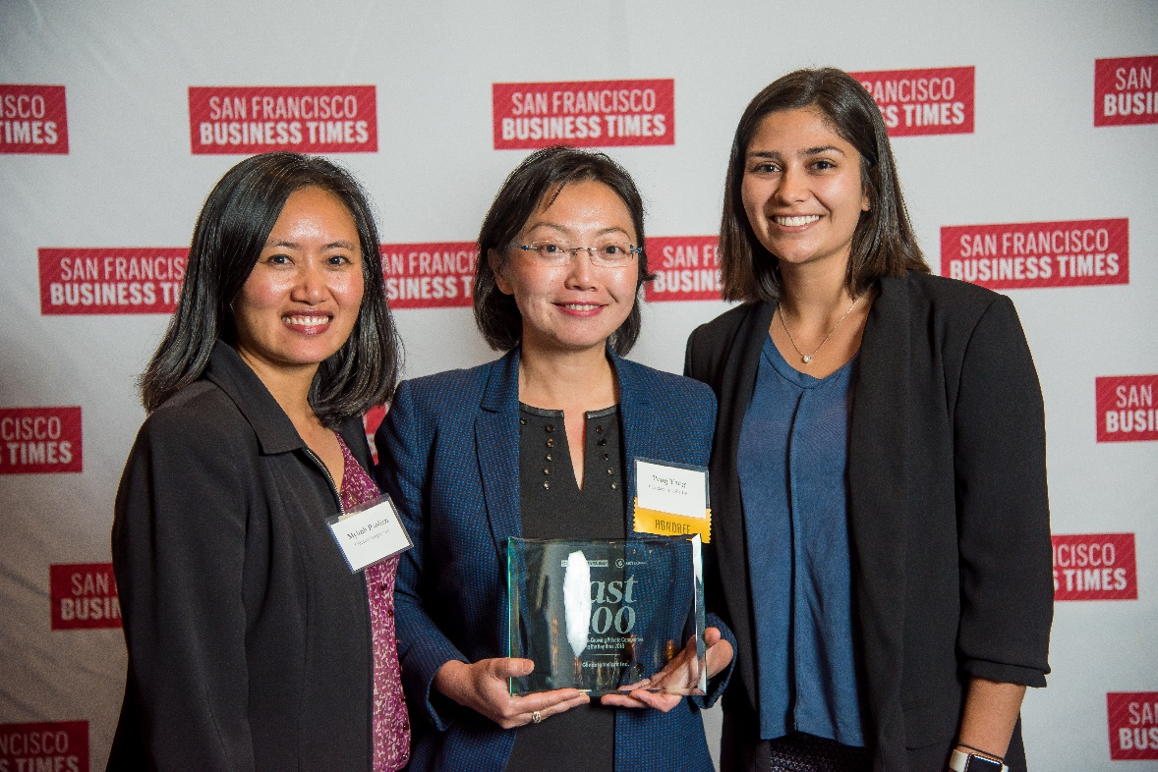
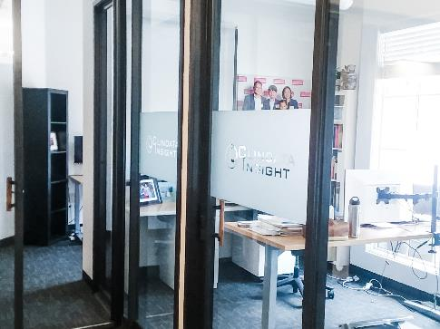
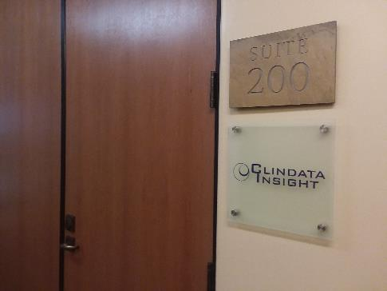
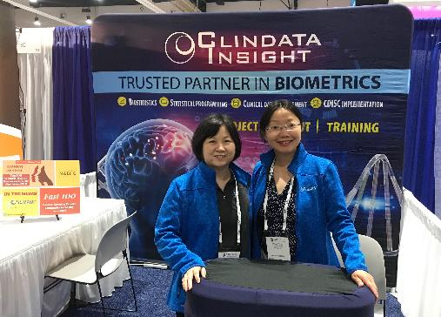
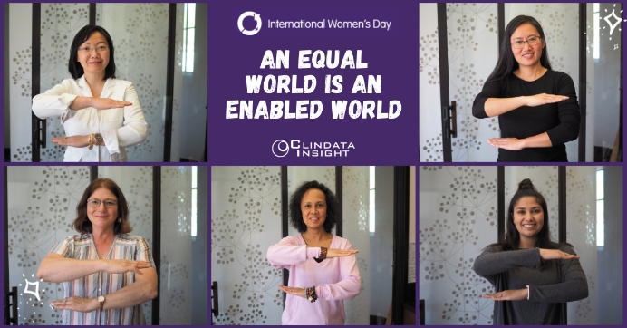
Something About Who We Are

Slide 3


We have been recognized as Top 100 Women-owned businesses in the Bay Area (2018-2021) by San Francisco Business Times.
Biometrics talent and project solutions for start-ups, mid-sized biotech, medical device companies, and large biopharma companies.
Serving 40% of the top 25 Biopharma companies in the Greater Bay Area with a returning customer rate of 85%.
WBENC Certified Women Business Enterprise (WBE) since 2016.

Slide 4

How to Transform from Technical to Business?

Slide 5
MBA is Not Needed
You can learn pretty much everything you desire at work.
Business school takes a long time and costs a lot.

Slide 6
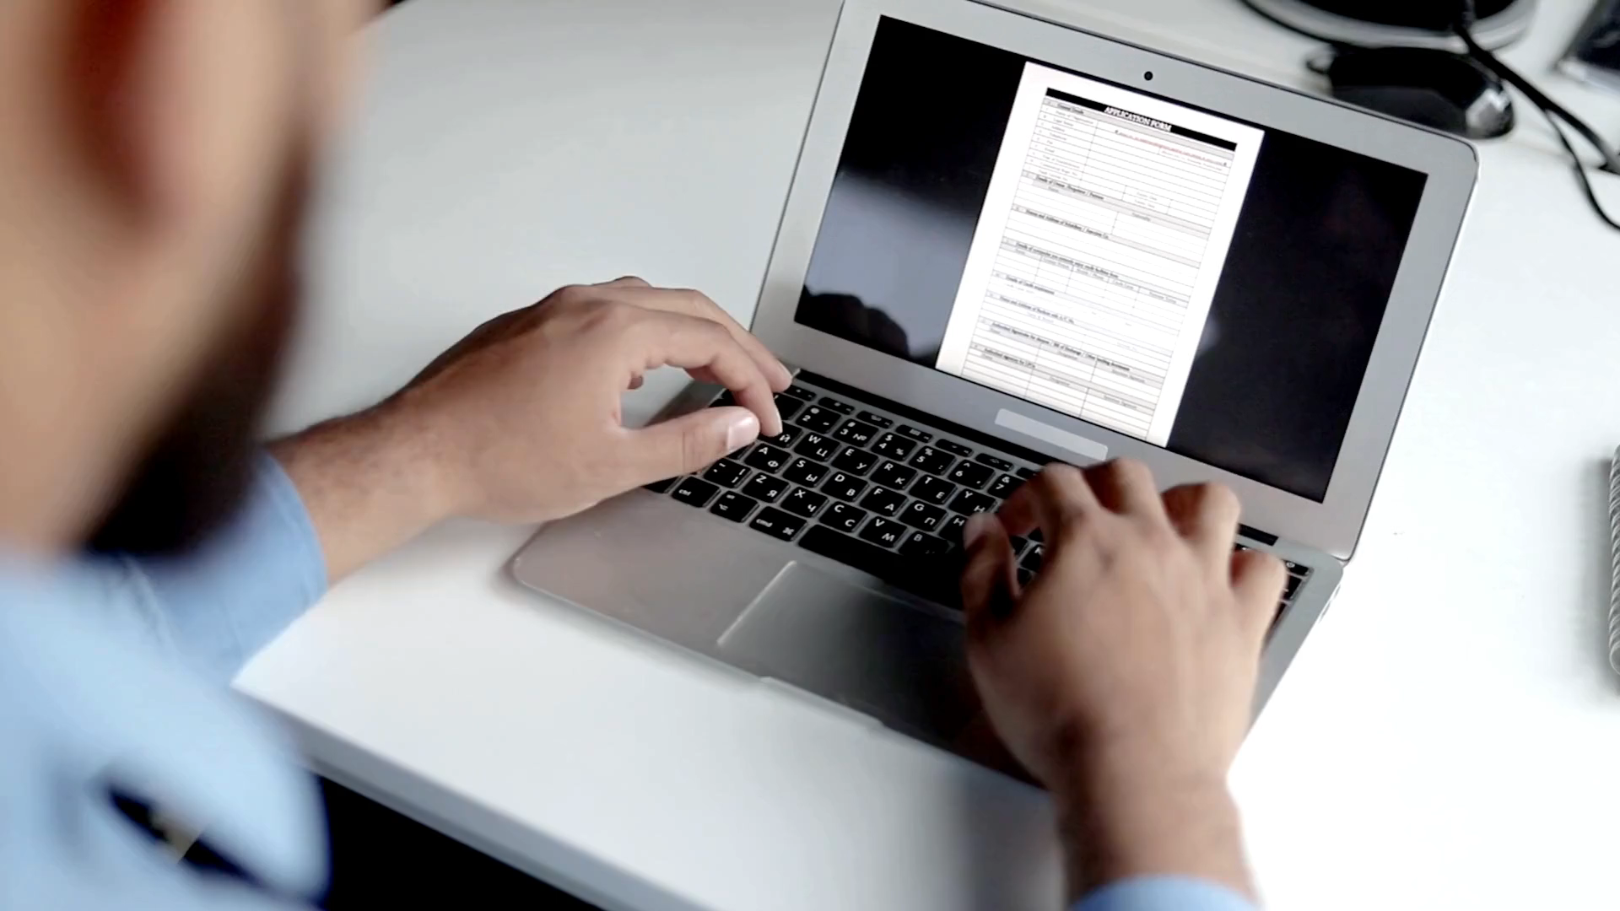
How to Learn Method 1 – Filling out Forms
The collected data serve a purpose.

Slide 7

How to Learn Method 2 – Learn from Service Vendors
Participate
Rinse and Repeat

Slide 8



How to learn Method 3 – Learning a Little Bit from Many People

Slide 9



How to Learn Method 4 – from Costly Mistakes that Really Hurt
Making the same mistake twice?

Slide 10


How to learn Method 5 – From Getting No’s from People
No means “Not Now”
and “New Opportunities”
What is the true reason behind the No?

Slide 11



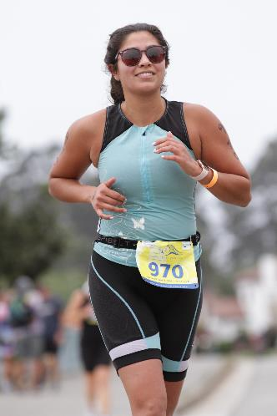

How to learn Method 6 – Learn from Wisdom and Inspiration
*Olympic Photos from The New Yorker

Slide 12

Open Book
Non Zero Sum
Believe in yourself and trust your intuition.

Slide 13



Thank You
650-255-8747
https://www.clindatainsight.com
pyang@clindatainsight.com

